Slide 1
How to use your SatNav
Getting the best out of your Oudie with SeeYou
Setting up your navboxes
Jon Hall

Slide 2
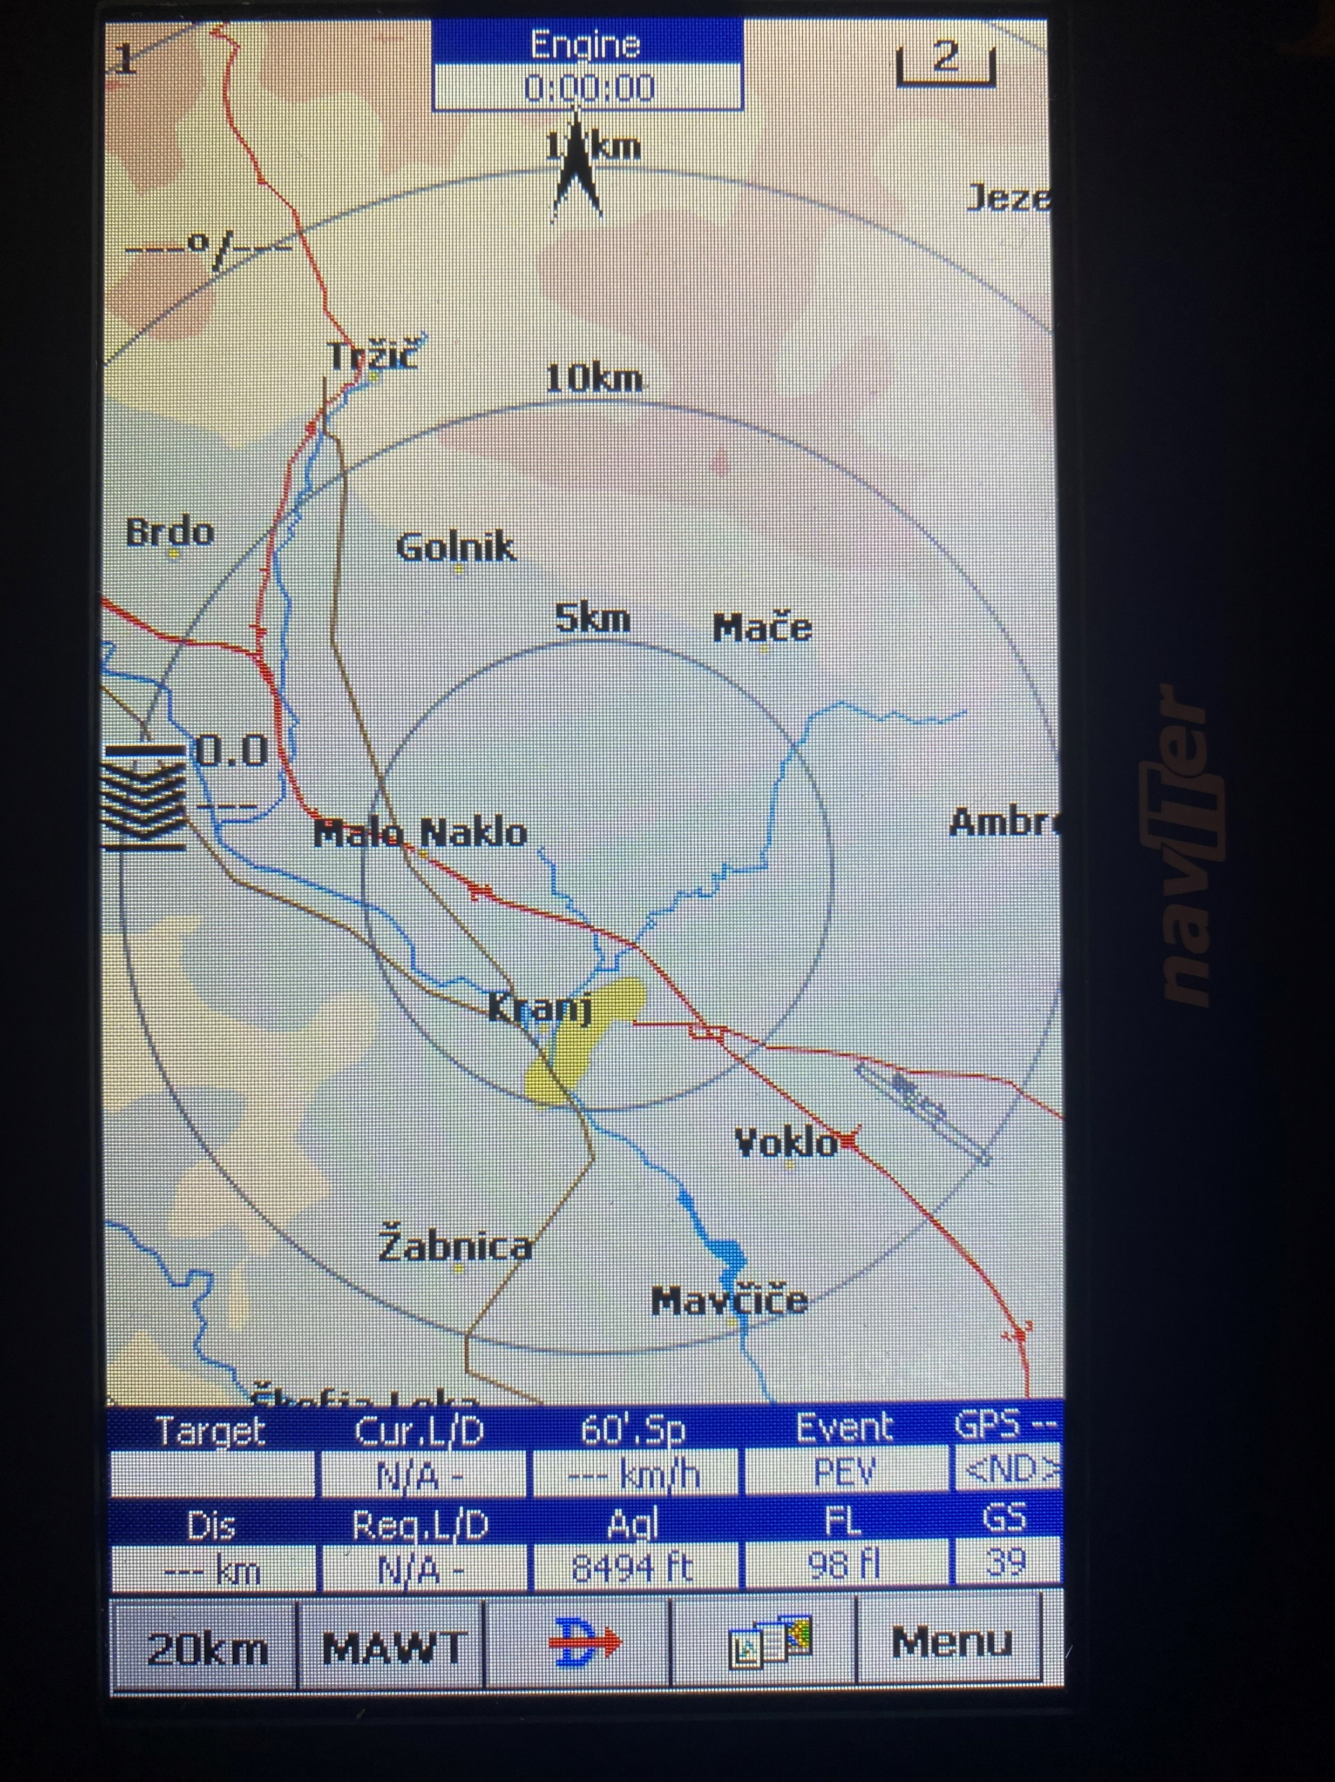
How to get Nav Boxes on your map
Open the MAP you want to use
Then click on MENU at the bottom
On new page click SETTINGS
Then click NAV BOXES
Then click NAV BOXES

Slide 3
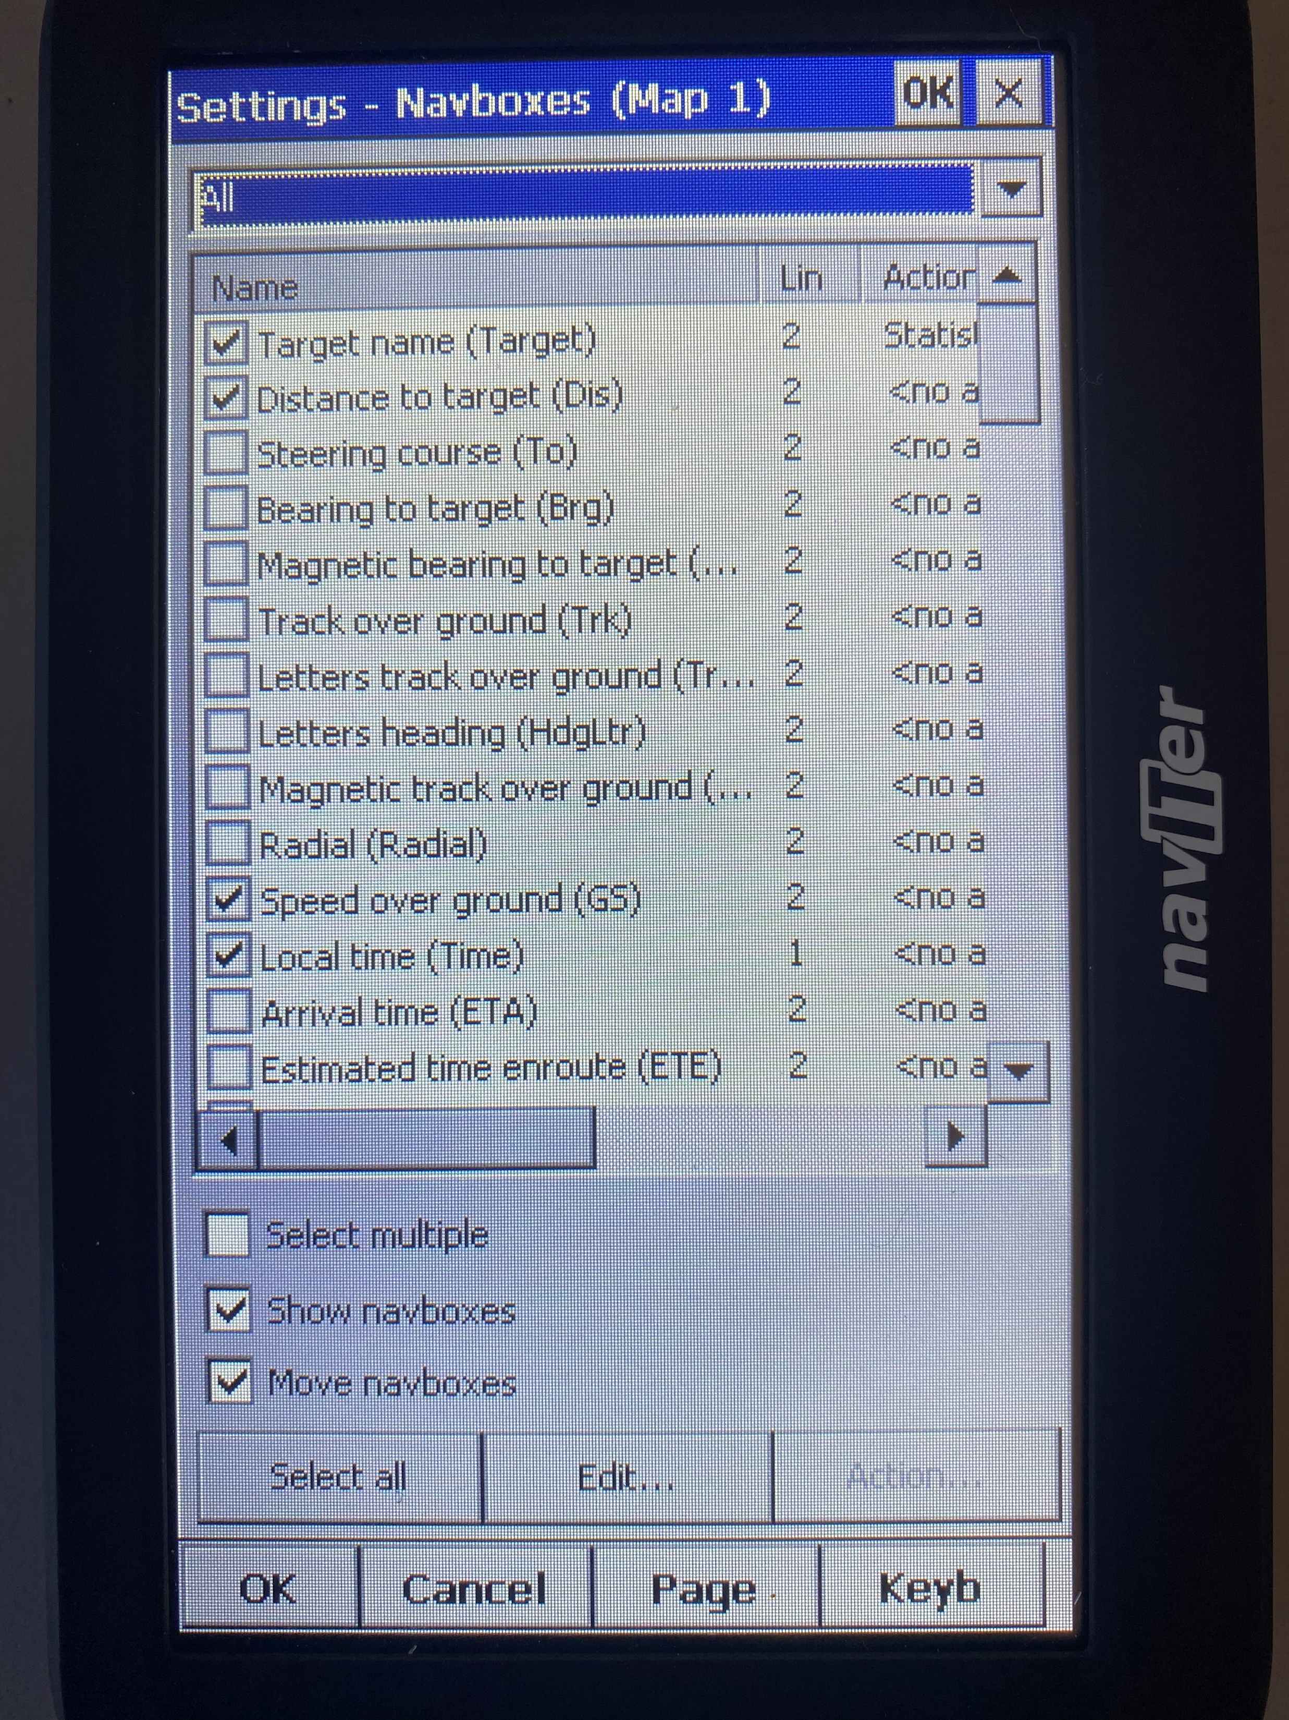
How to get Nav Boxes on your map
In the top drop down box click ALL
Then select each NAVBOX that you want to show on the map
At the bottom tick SHOW NAVBOXES and MOVE NAVBOXES
You can do this for each map that you use so they show different NAVBOXES
Then click NAV BOXES

Slide 4
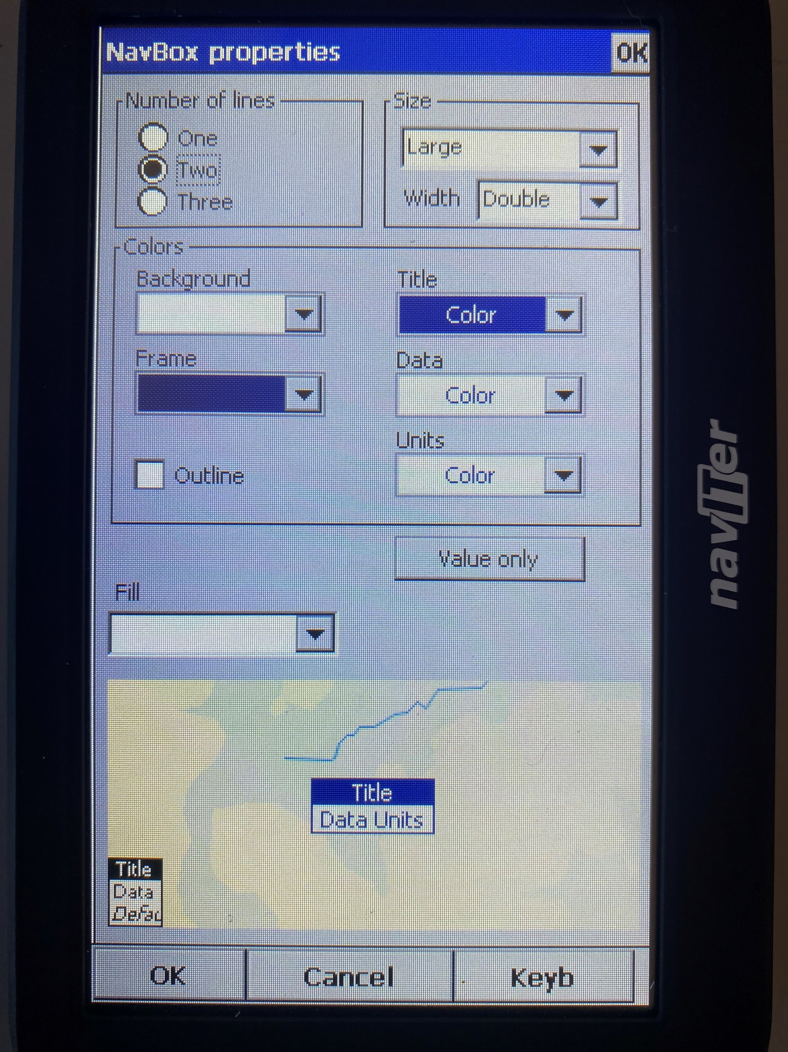
Select how you want the NAVBOXES to be set up
From the previous screen select and highlight the NavBox you want and click EDIT
This takes you to a PROPERTIES screen
This is where you change the size, colour and content

Slide 5
You can add an ACTION to each NAVBOX
to use it like a button to start another process or move to another screen
From the SETTINGS screen highlight the navbox and select ACTION

Slide 6
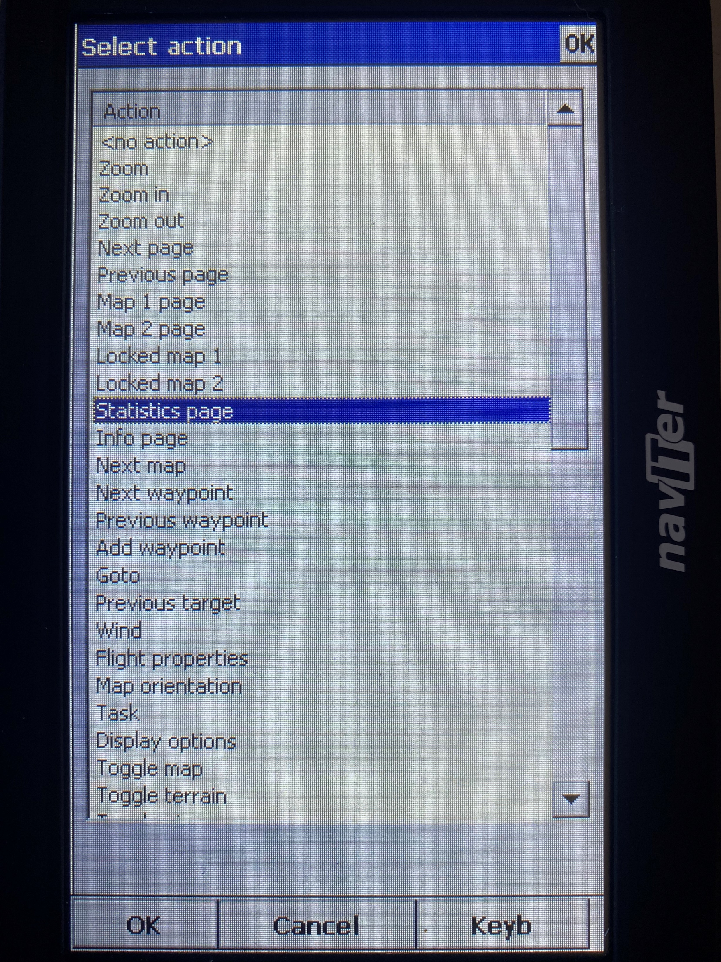
You can add an ACTION to each NAVBOX
In the ACTION screen select the action you want to assign to the box and click OK

Slide 7
How to position the NAVBOXES where you want them
Go back to the map and DRAG and DROP the NAVBOXES to the position you want
This applies to any item on the map, providing you have previously selected SHOW NAVBOXES and MOVE NAVBOXES in the SETTINGS page

Slide 8
How many should I have
I think you want as few boxes as possible so as not to clutter the map
This what I use
Engine run time
North indicator
Wind direction and speed
Glide calculator
Distance
Target
Current L/D
Required L/D
Average speed over last hour
Height above ground
Pilot marked event (like a wave hotspot)
Flight Level
GPS condition
Ground speed (useful for wave flights)

Slide 9
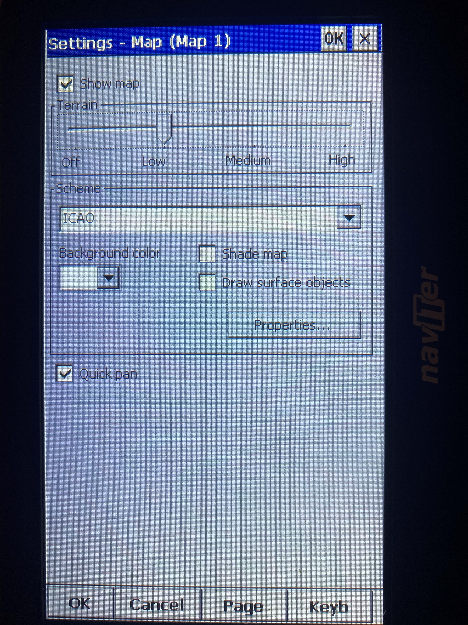
Setting up your map
KISS - KEEP IT SIMPLE (STUPID)
You really do not need lots of colours, terrain mapping, or other stuff
Just look out of the window if you need to know what the ground looks like
I use the ICAO colour scheme
With terrain set to LOW
WHITE as the background colour
No shading or surface objects
Make sure that QUICK PAN is ticked so you can drag the map around while flying

Slide 10
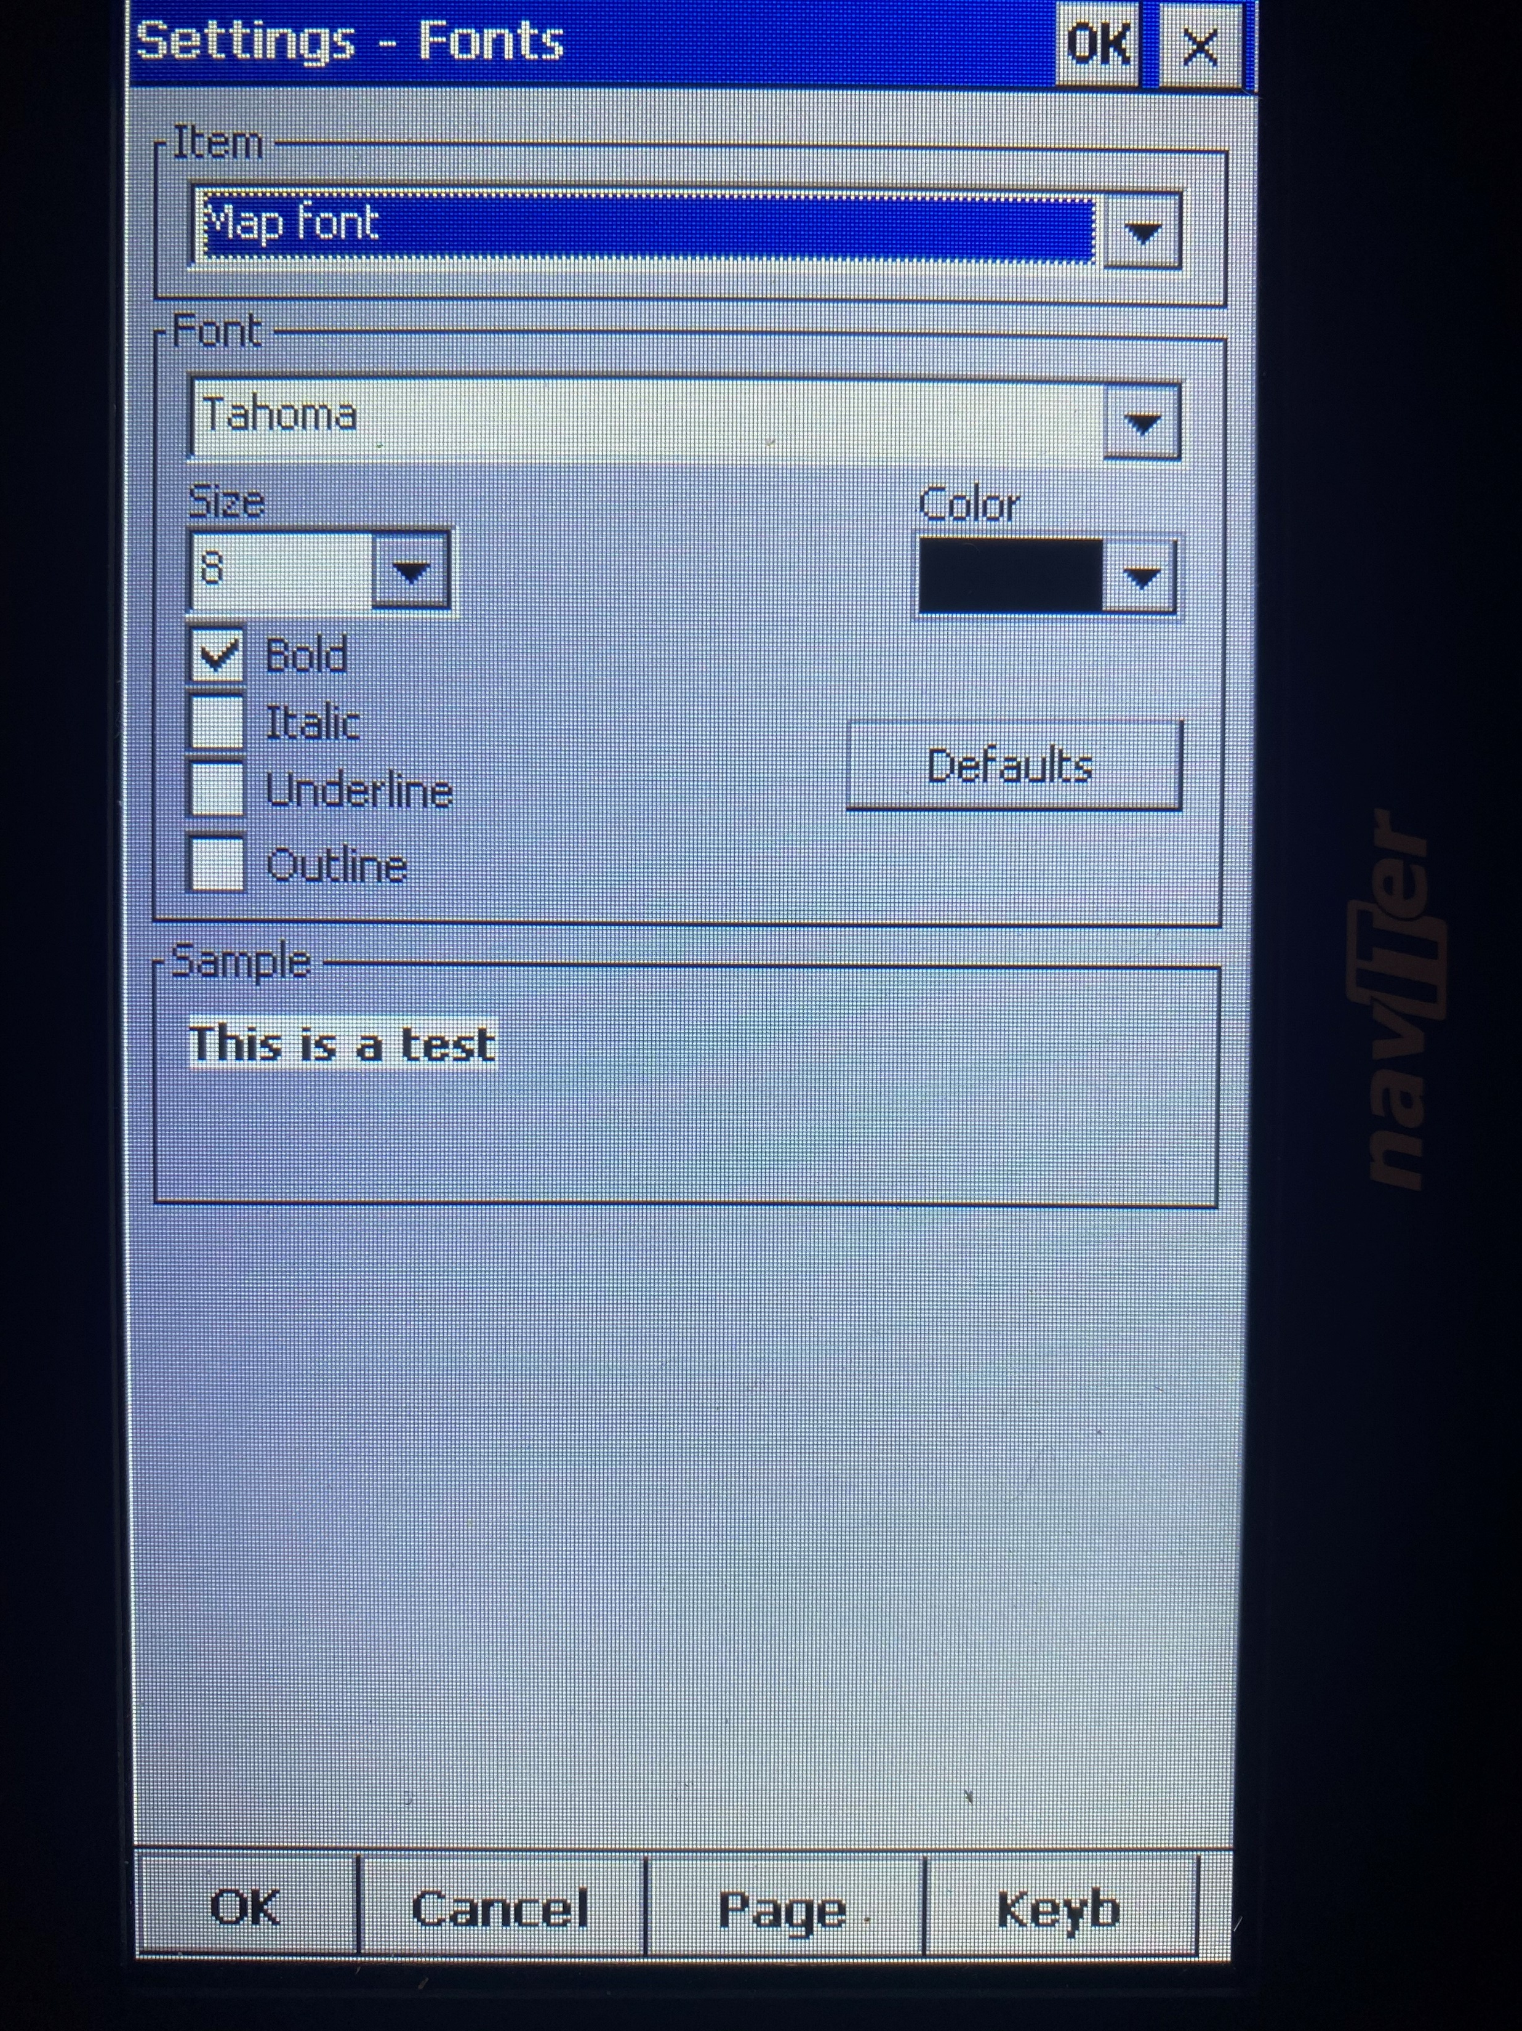
Make sure you can see the information on the screen
Select FONTS from the SETTINGS MENU
Here you can define all the Fonts throughout
In the ITEM drop down box at the top select MAP FONT (or any other font you want to change)
Then set it up as you like it
This is how I do it but your visual acuity will differ from mine

Slide 11
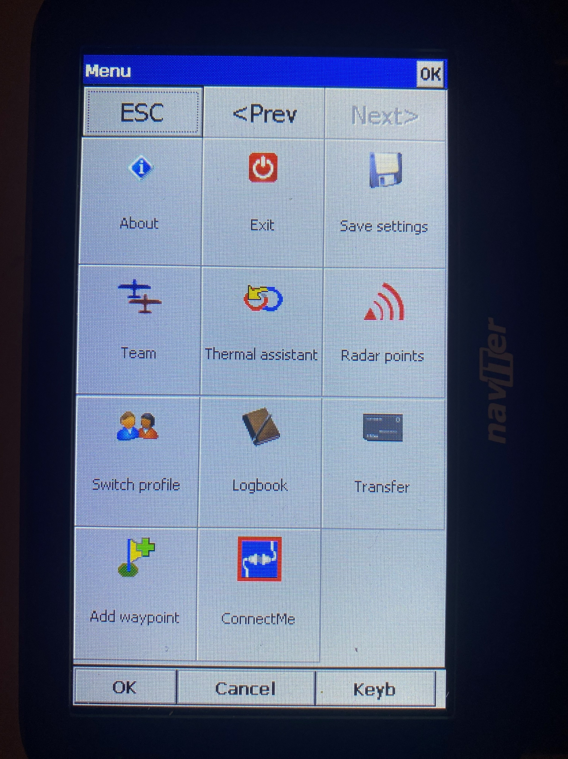
DON’T FORGET TO SAVE YOUR SETTINGS BEFORE EXITING
Or you will lose them
and you will have to do it
all over again

